Slide 1
Home Insurance Management system
Team Members
Abhishaik
Navya
Praveen
Vikram
Lokesh
Anil
Albin

Slide 2
Home Insurance management Introduction
Home insurance is a service that protects your house and belongings from damage or loss due to events like fire, theft, natural disasters, or accidents. If something bad happens, the insurance company helps you pay for the repairs or replacements.
Different Types of Home Insurance Polices
Policy issuance
Premium calculation
Claim processing
Customer communication
Risk evaluation

Slide 3
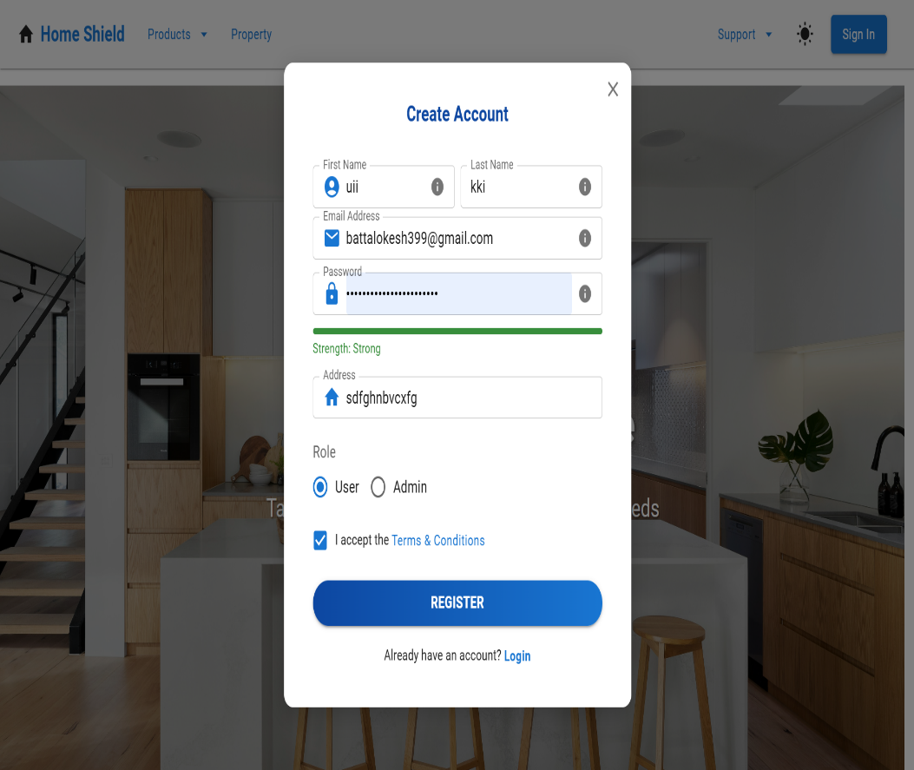
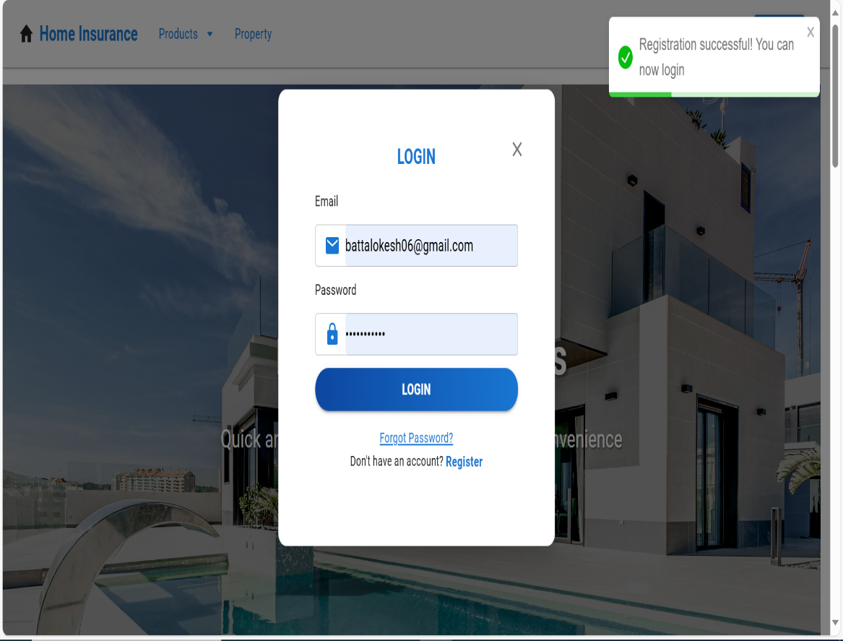
Register Page After registration success pop
As a Customer first we can Register Home Insurance page and Fill all above details ,After fill Details we can click register button we get success login pop

Slide 4
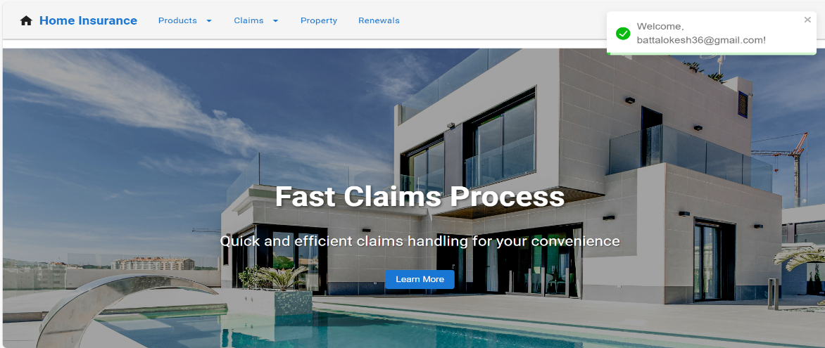
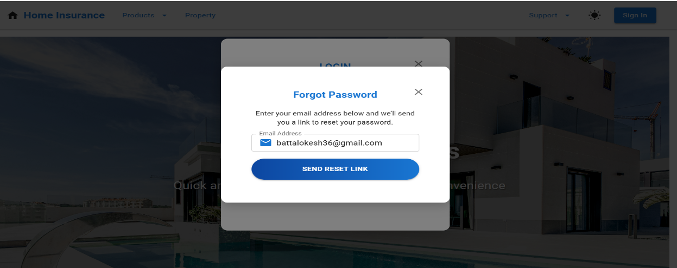
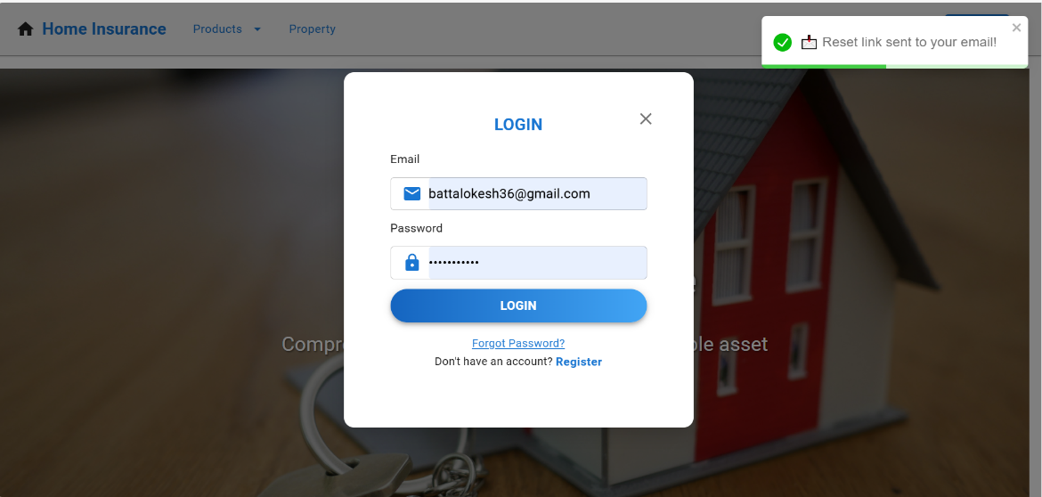
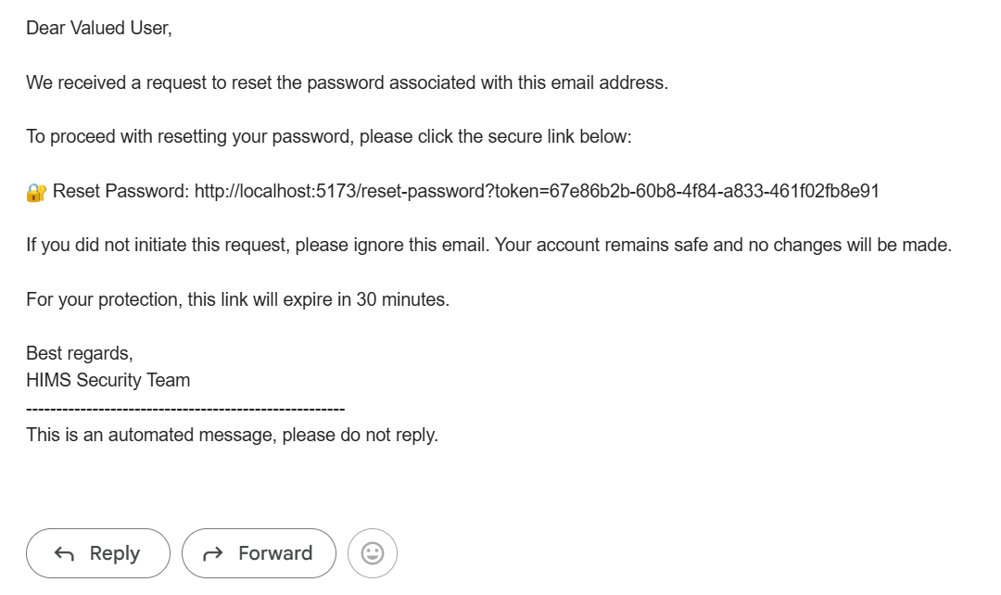
Login page Success and forget password send mail
After Login success you can see welcome to battalokesh36@gmail.com , in case you can forget password we can send mail after mail you can receive password or url link.

Slide 5
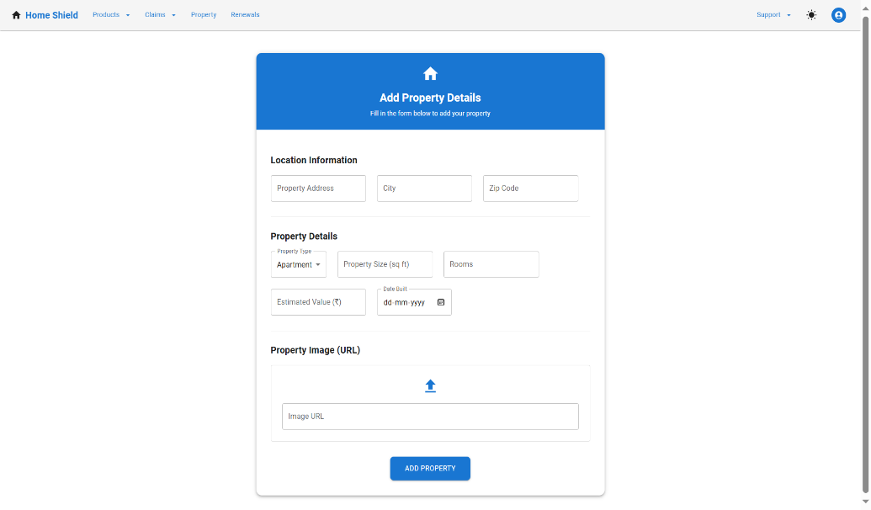
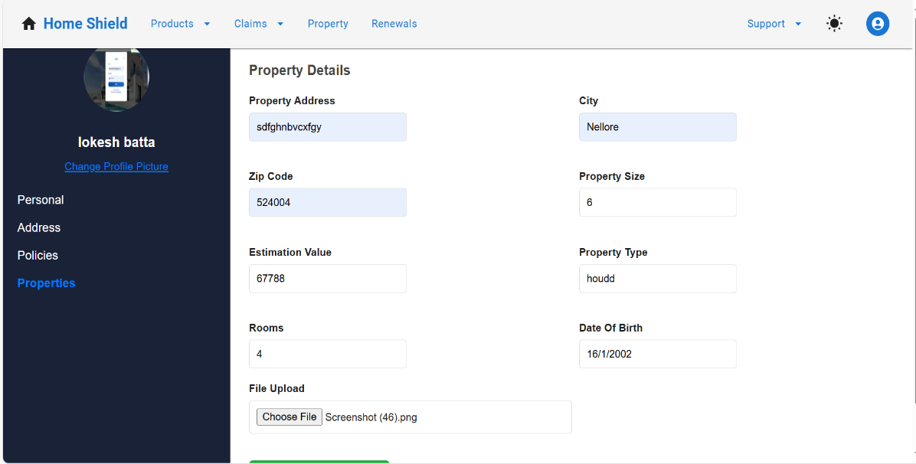
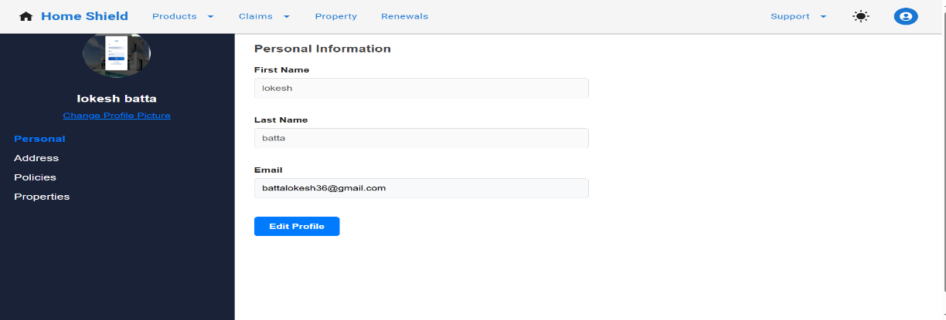
Add Property and Update User Details
Add property and as a user can be change details we can use with update profile like personal details, address , policies ,properties can be change

Slide 6
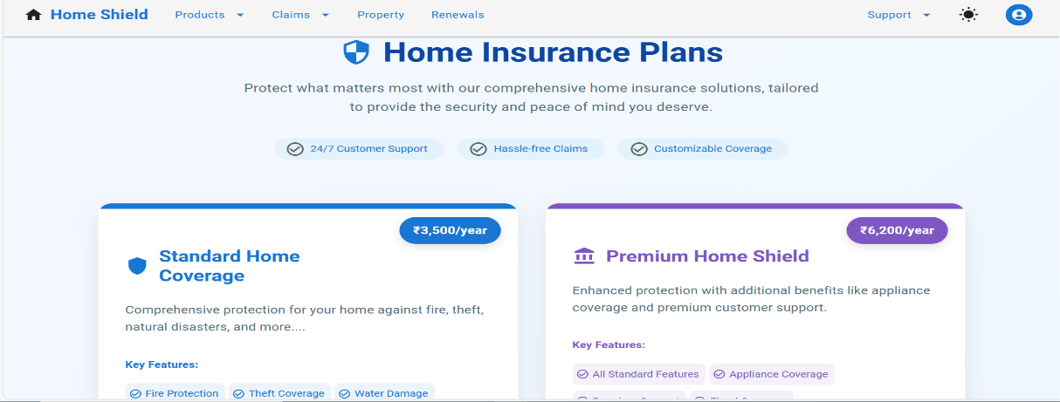
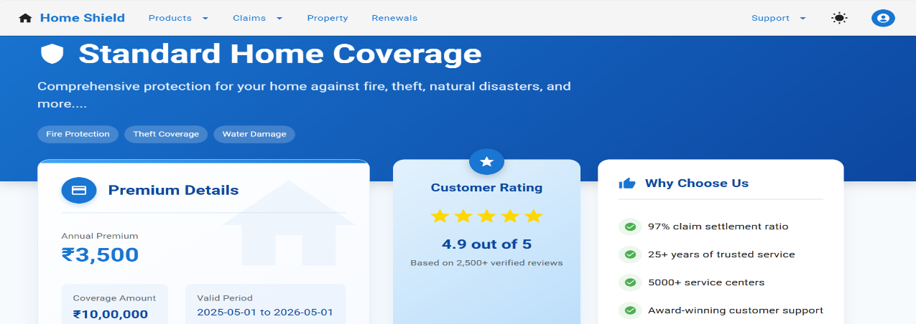
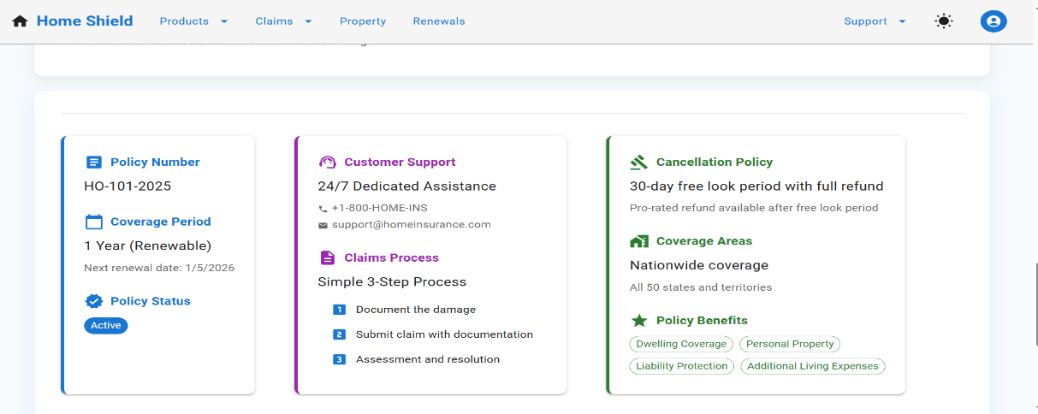
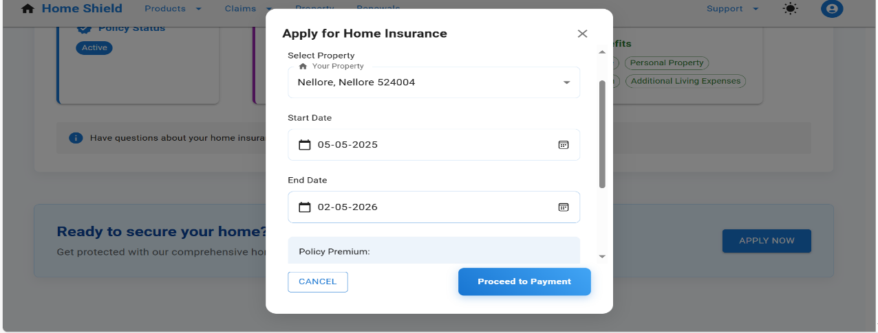
Home Insurance plans and how apply Home Insurance and Customer Care Support Details
Home Insurance have different insurance plans ,how can choose plans. If any doubts ask customer support and customer care rating and after proceed payment

Slide 7
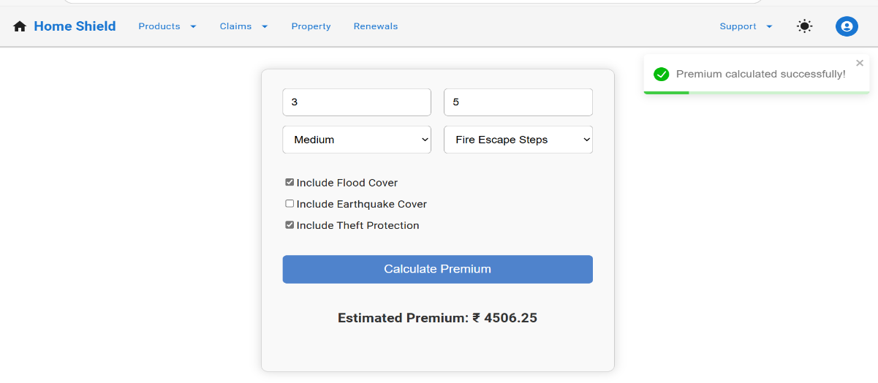
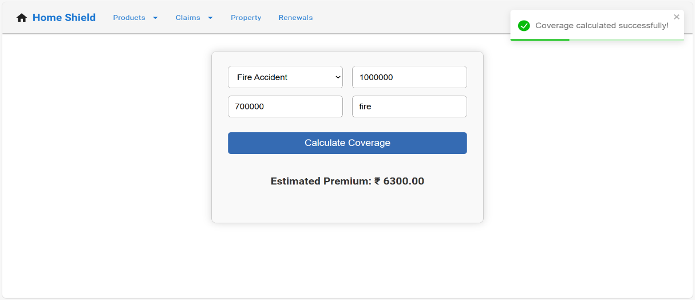
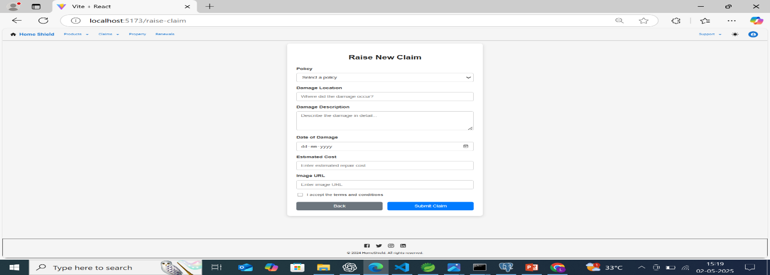
Premium , Coverage ,Raise new claim and track claim
How can calculate premium amount based on estimate amount and also coverage amount
If any damages in home we have raise new claim and track claim

Slide 8
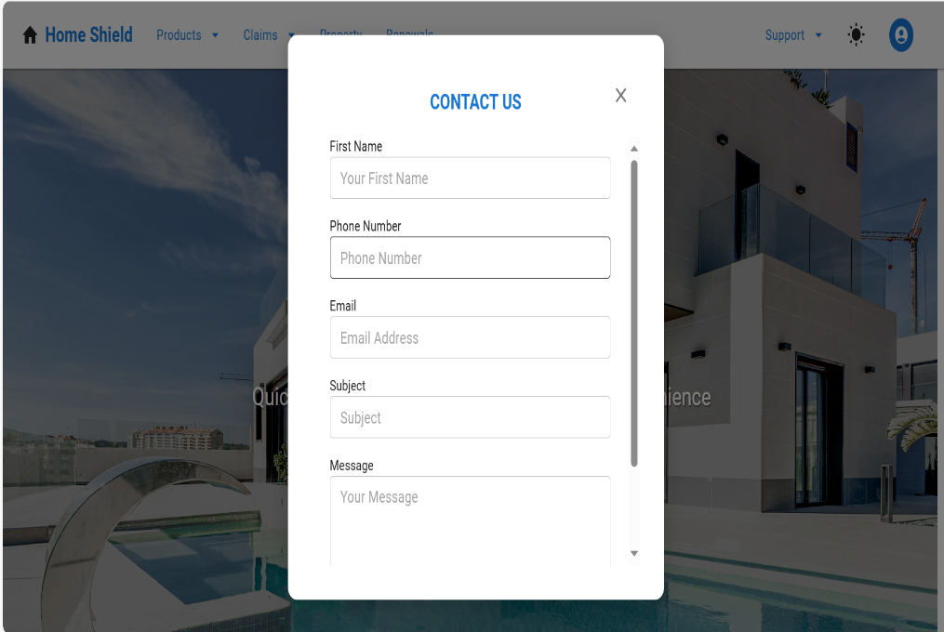
Contact us Chat support with customer
Users can ask questions about policy coverage, premium amounts, renewal dates, or claim processes.
if users face issues logging in, uploading documents, or making payments, they can get immediate support.

Slide 9
Technologies used in Home Insurance project
Frontend(React)
React js -Component-based UI
Axios – HTTP client for API calls
Material-UI(MUI)- UI component
React Hook Form – Form handling and validation
React Router – routing
Toastify – used in notifications
Backend (Spring boot)
Spring Boot – java –based backend frame work
Spring data jpa – ORM for Database operations( it can be connect database)
Spring Security and JWT Token – Authentication and authorization
Lombok – Reduces boilerplate code ( generate getters and setters and constructors)
Data Base and other tools
Postgres SQL – for relational data base
Postman –API testing

Slide 10
Thank you

